Slide 1
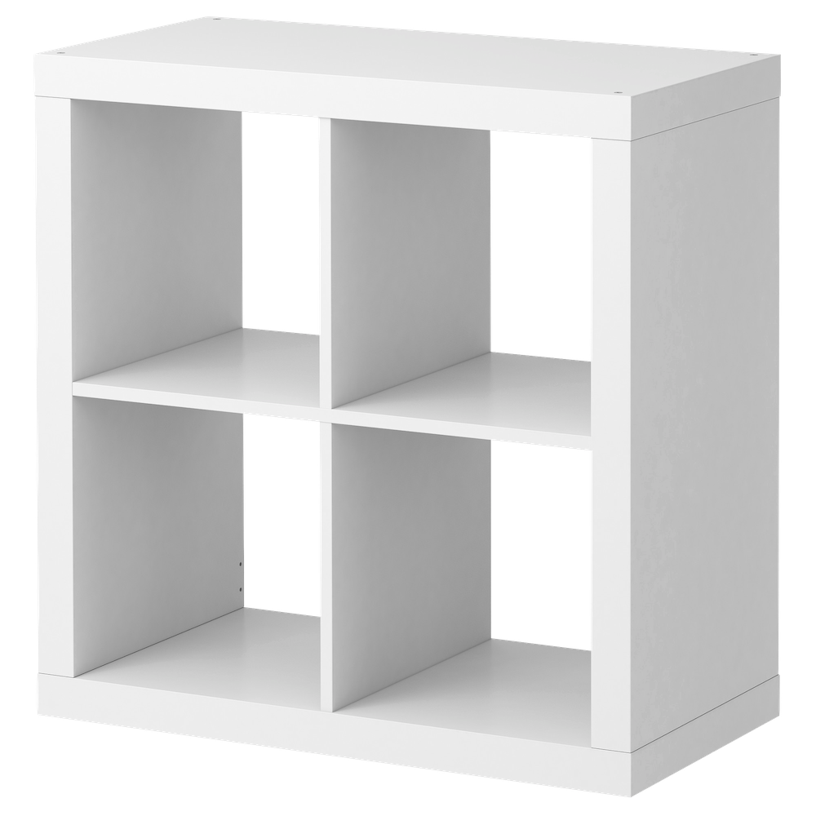

1
Problem Overview
2
Mission & Objectives
3
Room Network
4
Star Schema
Group 1:
Alex, Jon, Louis, Maëlys, Teghwin, Thomas
5
Key Takeaways
Notes:
maelys

Slide 2
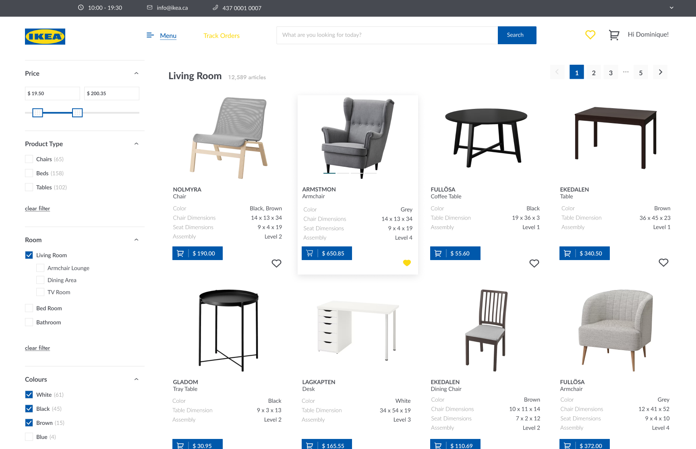
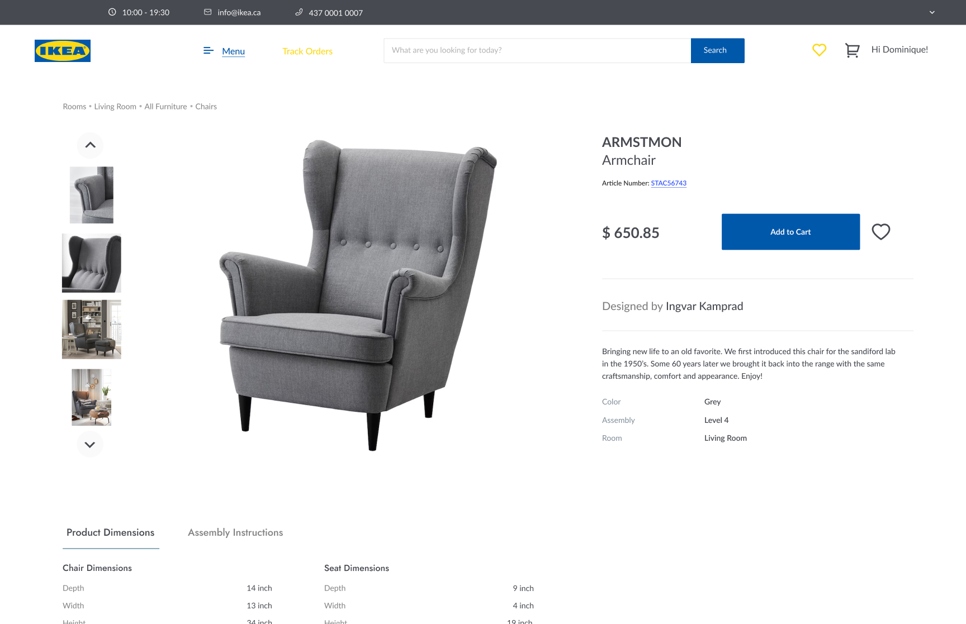
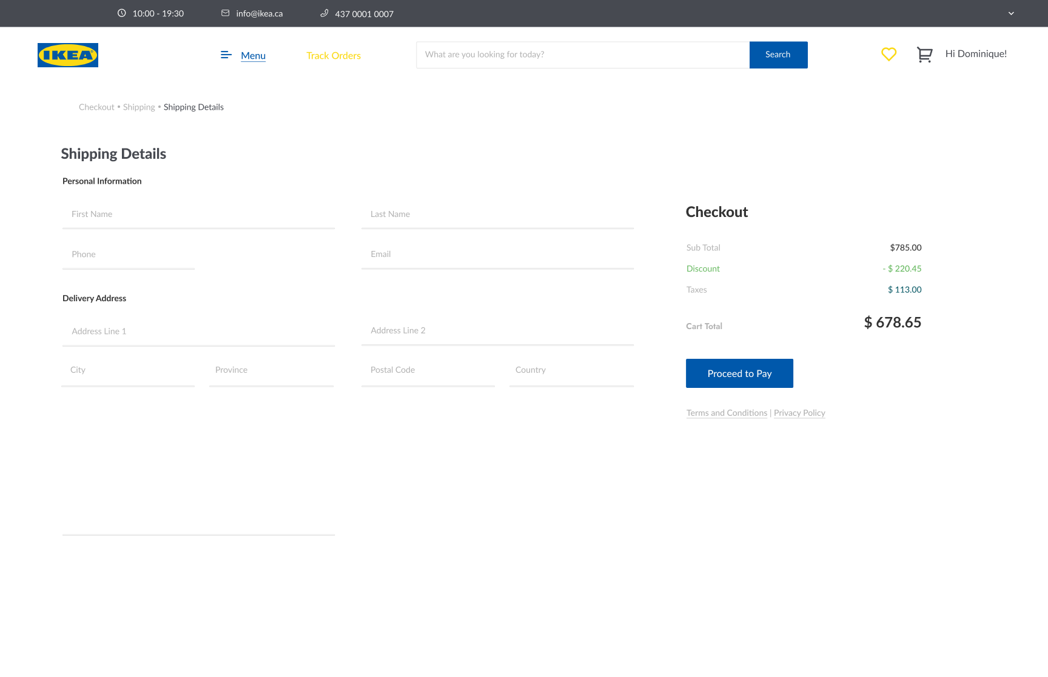
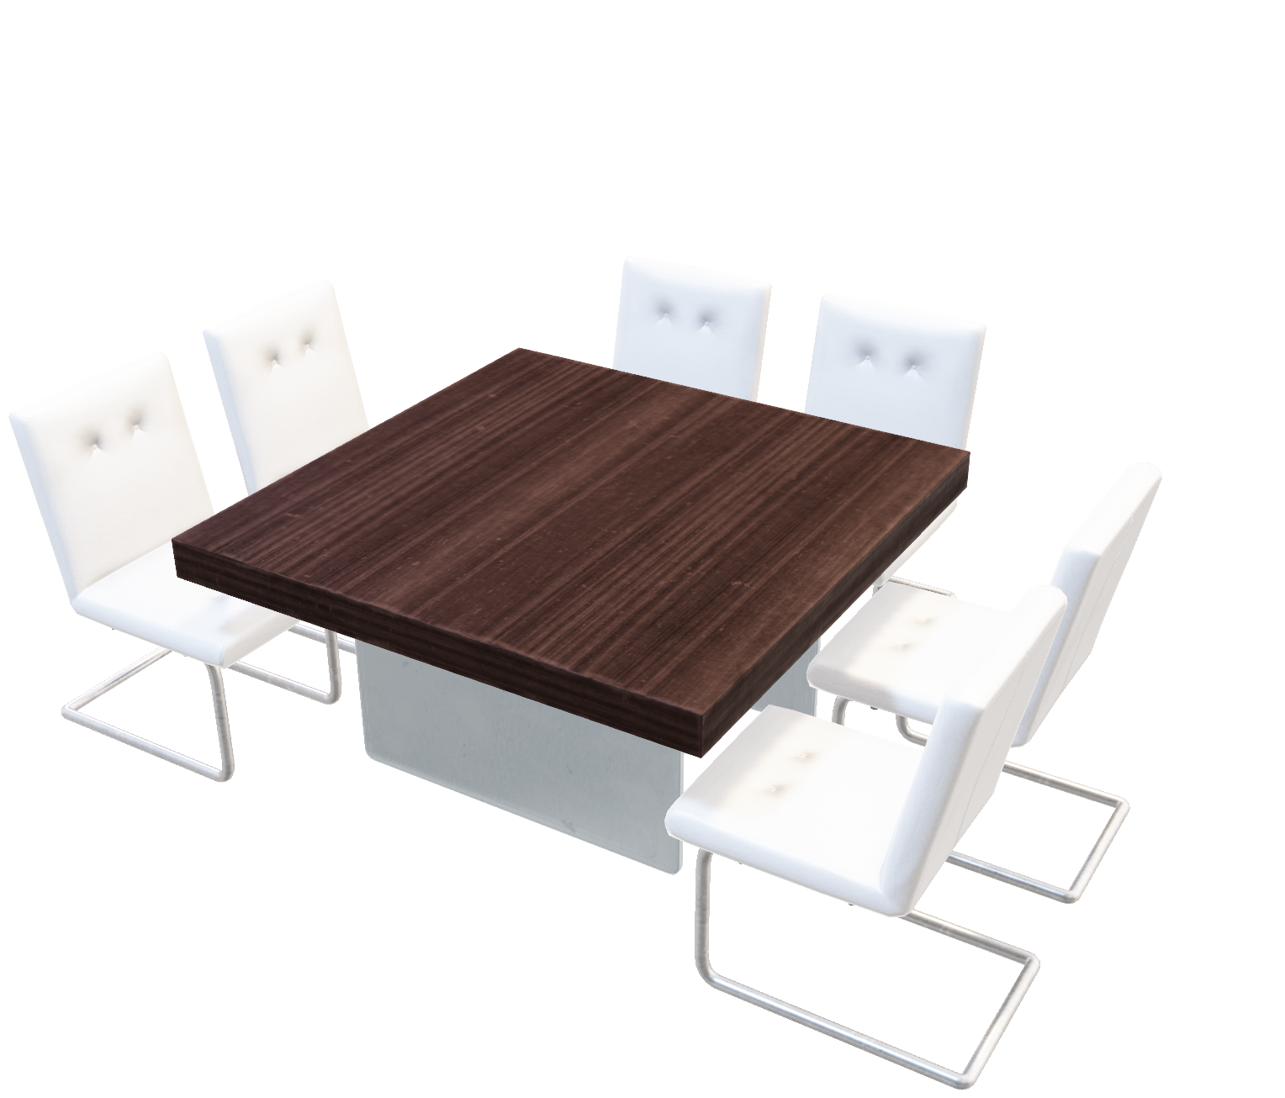
Agenda
1
Problem Overview
2
Mission & Objectives
3
Room Network
4
Star Schema
5
Key Takeaways
Problem Overview
Mission & Objectives
Room Network
Star Schema
Key Takeaways
Browsing Page
Product Page
Checkout Page
Notes:
maelys
Problem Overview
Mission & Objectives
Value Proposition
Graph Database
(Implementation)
Star Schema
Key Takeaways

Slide 3
Problem Overview
1
Problem Overview
2
Mission & Objectives
3
Room Network
4
Star Schema
5
Key Takeaways
Goal: Expand Online Presence & Manage Data Efficiently
Products, Categories, Customers, Orders
To Maintain Data On:
Product, Customer, & Order Management
To Support:
Objectives:
Products, Orders, Customers
To Perform Searches On:
Products, Orders, Customers
To Report On:
Payment Gateways and Safely Process Payments
To Integrate:
Browsing Page
Product Page
Checkout Page
Problem Overview
Mission & Objectives
Room Network
Star Schema
Key Takeaways
Notes:
maelys

Slide 4



Mission & Objective
Transaction Database
Room Network
Marketing MDDB
Mission Statement: Support IKEA's website operations and maintenance by providing granular data on its customers and their respective orders, as well as facilitating inventory management by keeping updated records on available products.
To Maintain Data On:
Articles, Categories, Customers, Orders
To Support:
Articles, Customer, Order Management
Objectives:
To Perform Searches On:
Articles, Orders, Customers
To Report On:
Articles, Orders, Customers
To Integrate:
Payment Gateways and Safely Process Payments
Problem Overview
Mission & Objectives
Room Network
Star Schema
Key Takeaways
Notes:
maelys
Mission Statement The purpose of this database is to support IKEA's website operations and maintenance by providing granular data on its customers and their respective orders, as well as facilitating inventory management by keeping updated records on available products.
Objectives
To maintain (enter, update, and delete) data on products
To maintain (enter, update, and delete) data on categories
To maintain (enter, update, and delete) data on customers
To maintain (enter, update, and delete) data on orders
To support product catalog management
To support customer management
To support order management
To support cashflow management
To perform searches on products
To perform searches on orders
To perform searches on customers
To report on products
To report on orders
To report on customers
To integrate payment gateways and safely process payments

Slide 5

Value Proposition
If Not Designed Logically
1
Unnecessary Duplication of Data
Increased
Costs
a
Insertion
2
Anomalies
b
Deletion
c
Modification
Transaction Database
Room Network
Marketing MDDB
3
Lack of Flexibility Across Articles
3 Complementary Data Management Propositions
Problem Overview
Mission & Objectives
Room Network
Star Schema
Key Takeaways
Notes:
maelys
Transaction Database (ERP) -> Alex & Louis
MDDB for Marketing purposes (Datamart or CRM?) -> Tom & Teggy
Neo4j to manage Rooms () -> Jonathan

Slide 6


Countless Transactions…
SOLUTION
IKEA RDBMS
OUTCOMES
IKEA Online Sales
If Not Designed Logically
Third Normal Form
CUSTOMERS
ORDERS
Decrease Maintenance
Need and Costs
2022: IKEA Canada generated
1
Unnecessary Duplication of Data
verifies
contains
All Entities have Full dependencies.
Avoids Data Redundancy
Avoids all 3 anomalies
Ensure better quality of Data
PAYMENTS
ORDER_DETAILS
$ 2.6Bn
Increased
Costs
contains
a
Insertion
ROOM
ARTICLE
190M Online Visits
2
Anomalies
b
Deletion
belongs to
Minimize the Number of Errors and Data Loss
ARTICLE_TYPE:
d
$640M in Online Sales
c
Modification
Enhanced-ERD
3
Lack of Flexibility Across Articles
“Chair”
“Bed”
“Table”
Conclusion: E-Commerce is Booming
CHAIR
BED
TABLE
Use of Subtype/Supertype in Article Types
Extra flexibility with the Articles
Removal of Null Values
Scalability of Article Types & Rooms
Appendix 1: Full EERD
What is Our Proposed Solution?
Source: IKEA Corporate News
Problem Overview
Mission & Objectives
Room Network
Star Schema
Key Takeaways
Transaction Database
Room Network
Marketing MDDB
Notes:
Alex
there are multiple themes (entity types) in one relation. This results in duplication and an unnecessary dependency between the entities
If not designed logically can lead to Data Redundancy.
Insertion Anomaly: adding new rows forces user to create duplicate data
○ Deletion Anomaly: deleting rows may cause a loss of data that would be needed for other future rows
○ Modification Anomaly: changing data in a row forces changes to other rows because of duplication
https://www.ikea.com/ca/en/newsroom/corporate-news/ikea-canada-reports-sales-of-usd2-59b-in-2021-as-life-at-home-continues-to-evolve-puba73cee67#:~:text=IKEA%20Canada%20total%20sales%20increased,per%20cent%20to%20%24969.48M.
Transaction Database (ERP) -> Alex & Louis
MDDB for Marketing purposes (Datamart or CRM?) -> Tom & Teggy
Neo4j to manage Rooms () -> Jonathan

Slide 7


Efficient Tracking of Transactions
Impact
IKEA RDBMS
SOLUTION
OUTCOMES
Third Normal Form
Enhanced-ERD
CUSTOMERS
ORDERS
verifies
Decrease Maintenance
Need and Costs
contains
All Entities have Full dependencies.
Use of Subtype/Supertype in Article Types
PAYMENTS
ORDER_DETAILS
contains
ROOM
ARTICLE
belongs to
Data Redundancy
Null Values
Minimize the Number of Errors and Data Loss
ARTICLE_TYPE:
d
“Chair”
“Bed”
“Table”
Anomalies
Article Flexibility
CHAIR
BED
TABLE
Quality of Data
Scalability of Article Types & Rooms
Appendix 1: Full EERD
Problem Overview
Mission & Objectives
Room Network
Star Schema
Key Takeaways

Slide 8



Minimizes Operating Risks
Impact
OUTCOMES
Decrease Maintenance
Need and Costs
Minimize Number of Errors and Data Loss
Scalability of
Article & Rooms
Problem Overview
Mission & Objectives
Room Network
Star Schema
Key Takeaways
Notes:
Transaction Database (ERP) -> Alex & Louis
MDDB for Marketing purposes (Datamart or CRM?) -> Tom & Teggy
Neo4j to manage Rooms () -> Jonathan

Slide 9
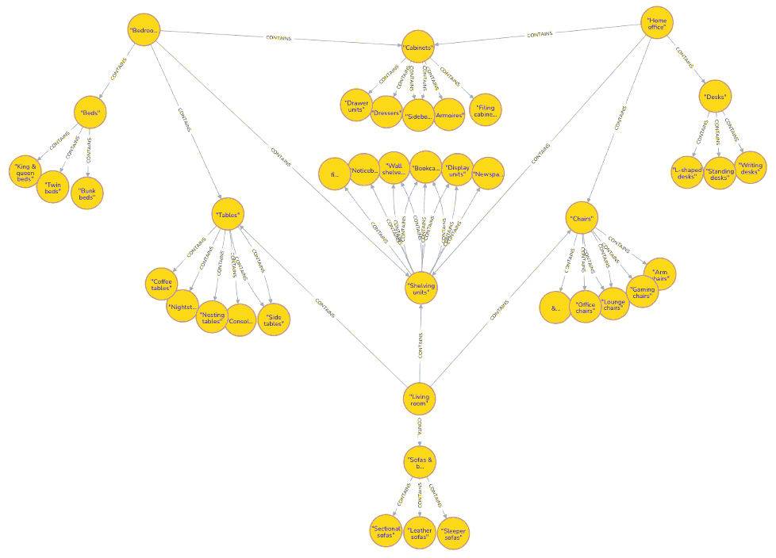

Impact
Efficient Tracking of Transactions
Living Room
IKEA RDBMS
OUTCOMES
Strategic Insights
User’s Supported Functionalities
SOLUTION
Lvl 1:
Home Office
Third Normal Form
Bedroom
CUSTOMERS
ORDERS
What are the most popular rooms?
Which product lines generates the highest sales?
Product Filtering
Order Cancelling
Decrease Maintenance
Need and Costs
verifies
contains
All Entities have Full dependencies.
Avoids Data Redundancy
Avoids all 3 anomalies
Ensure better quality of Data
PAYMENTS
ORDER_DETAILS
Beds
Cabinets
Lvl 2:
contains
Room Name | Number of Orders
Tables | 3
Chairs | 2
Bedroom | 1
Dining sets | 1
Product Line | Total Sales
Table | 17,265.97
Chair | 2,260.98
Order Tracking
Order Placement
Tables
Shelves
ROOM
ARTICLE
belongs to
Minimize the Number of Errors and Data Loss
Beds: King & queen, twin, bunk
ARTICLE_TYPE:
d
Enhanced-ERD
Tables: Desks, nightstands, side tables
“Chair”
“Bed”
“Table”
Lvl 3:
CHAIR
BED
TABLE
Cabinets: Dressers, armoires, side boards
Use of Subtype/Supertype in Article Types
Extra flexibility with the Articles
Removal of Null Values
Scalability of Article Types & Rooms
Appendix 1: Full EERD
Shelves: Wall, display, bookcases
Gather insights and facilitate operations while making educated, data-driven strategic decisions
Problem Overview
Mission & Objectives
Room Network
Star Schema
Key Takeaways
Notes:
Louis
Demonstrate the impact our model has on your operations
Use it for strategic insights. For example:
We understand that company narrative done through your rooms. With our model, you can know which rooms in the website are user more drawn tto and where they make the most purchase. Alternatively, tou could see the lowest performing room.
Additionally, our model allows custtomers to interact with the website in multiple wyas:
- non-exhaustive list of supported functionalities available tto the user, but you can see that most are:
- Related to both browsing and order management: say all of them

Slide 10
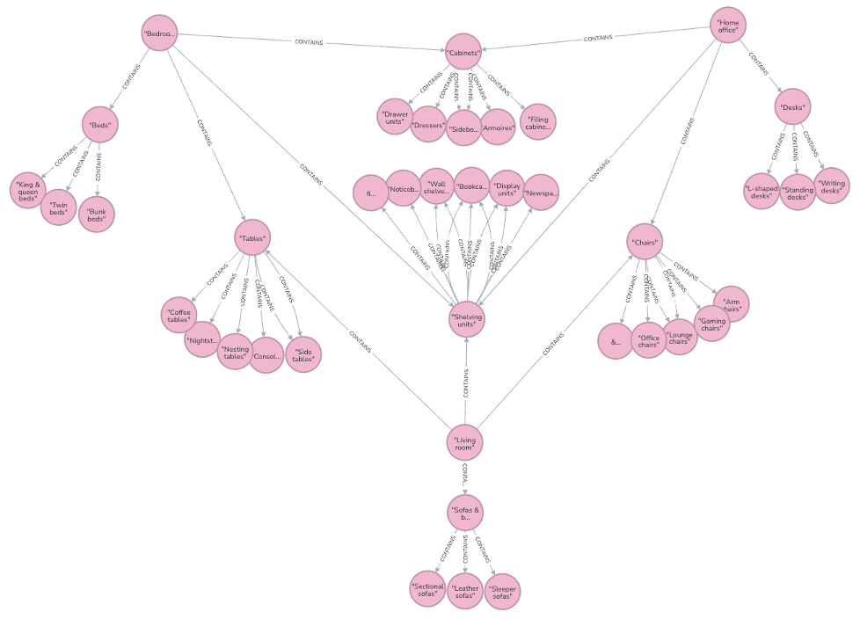
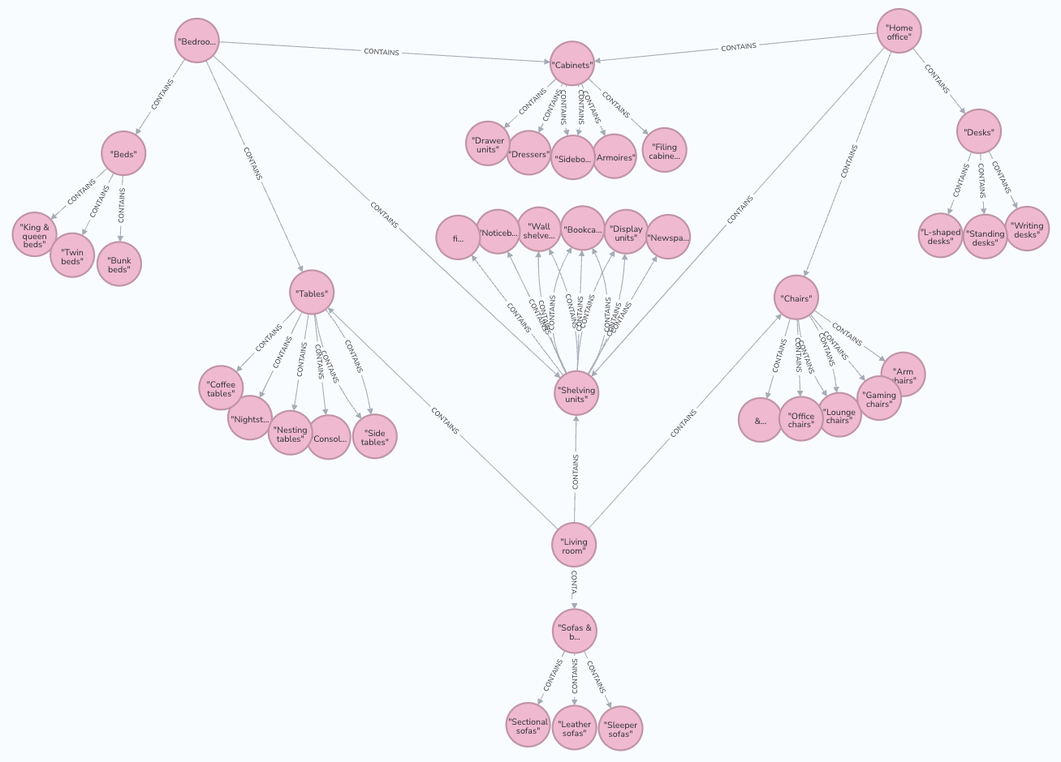
Room Network
Living Room
Question: How many types of rooms does each super room have?
Lvl 1:
Home Office
ROOM_HEADLINE | ROOM_COUNT
Tables | 6
Shelving Units | 6
Cabinets | 5
Chairs | 5
Bedroom | 4
Beds | 4
Bedroom
Beds
Cabinets
Lvl 2:
Value: More variety = More choice for customers. IKEA's marketing team can focus
Tables
Shelves
Beds: King & queen, twin, bunk
Tables: Desks, nightstands, side tables
Lvl 3:
Cabinets: Dressers, armoires, side boards
Note: Network does not reflect most up-to-date relationships
Shelves: Wall, display, bookcases
Problem Overview
Mission & Objectives
Room Network
Star Schema
Key Takeaways
Notes:
Jonathan
3 Levels of Rooms:
1st Level:
Bedroom
Living Room
Home Office
2nd Level (for Bedrooms):
Beds
Tables
Cabinets
Shelving Units
3rd Level (for Bedrooms):
Beds: King & queen, twin, bunk
Tables: Desks, nightstands, side tables
Cabinets: Dressers, armoirs, sideboards
Shelving units: wall, display, bookcases
Key takeaway: A lot of overlap
Same type of room can be present in many rooms

Slide 11
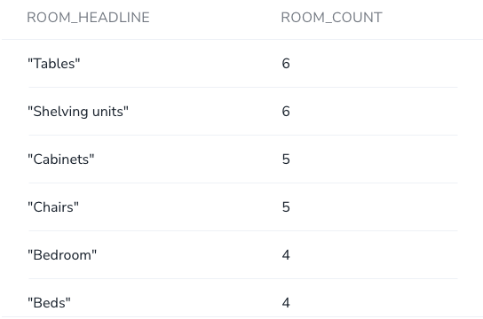
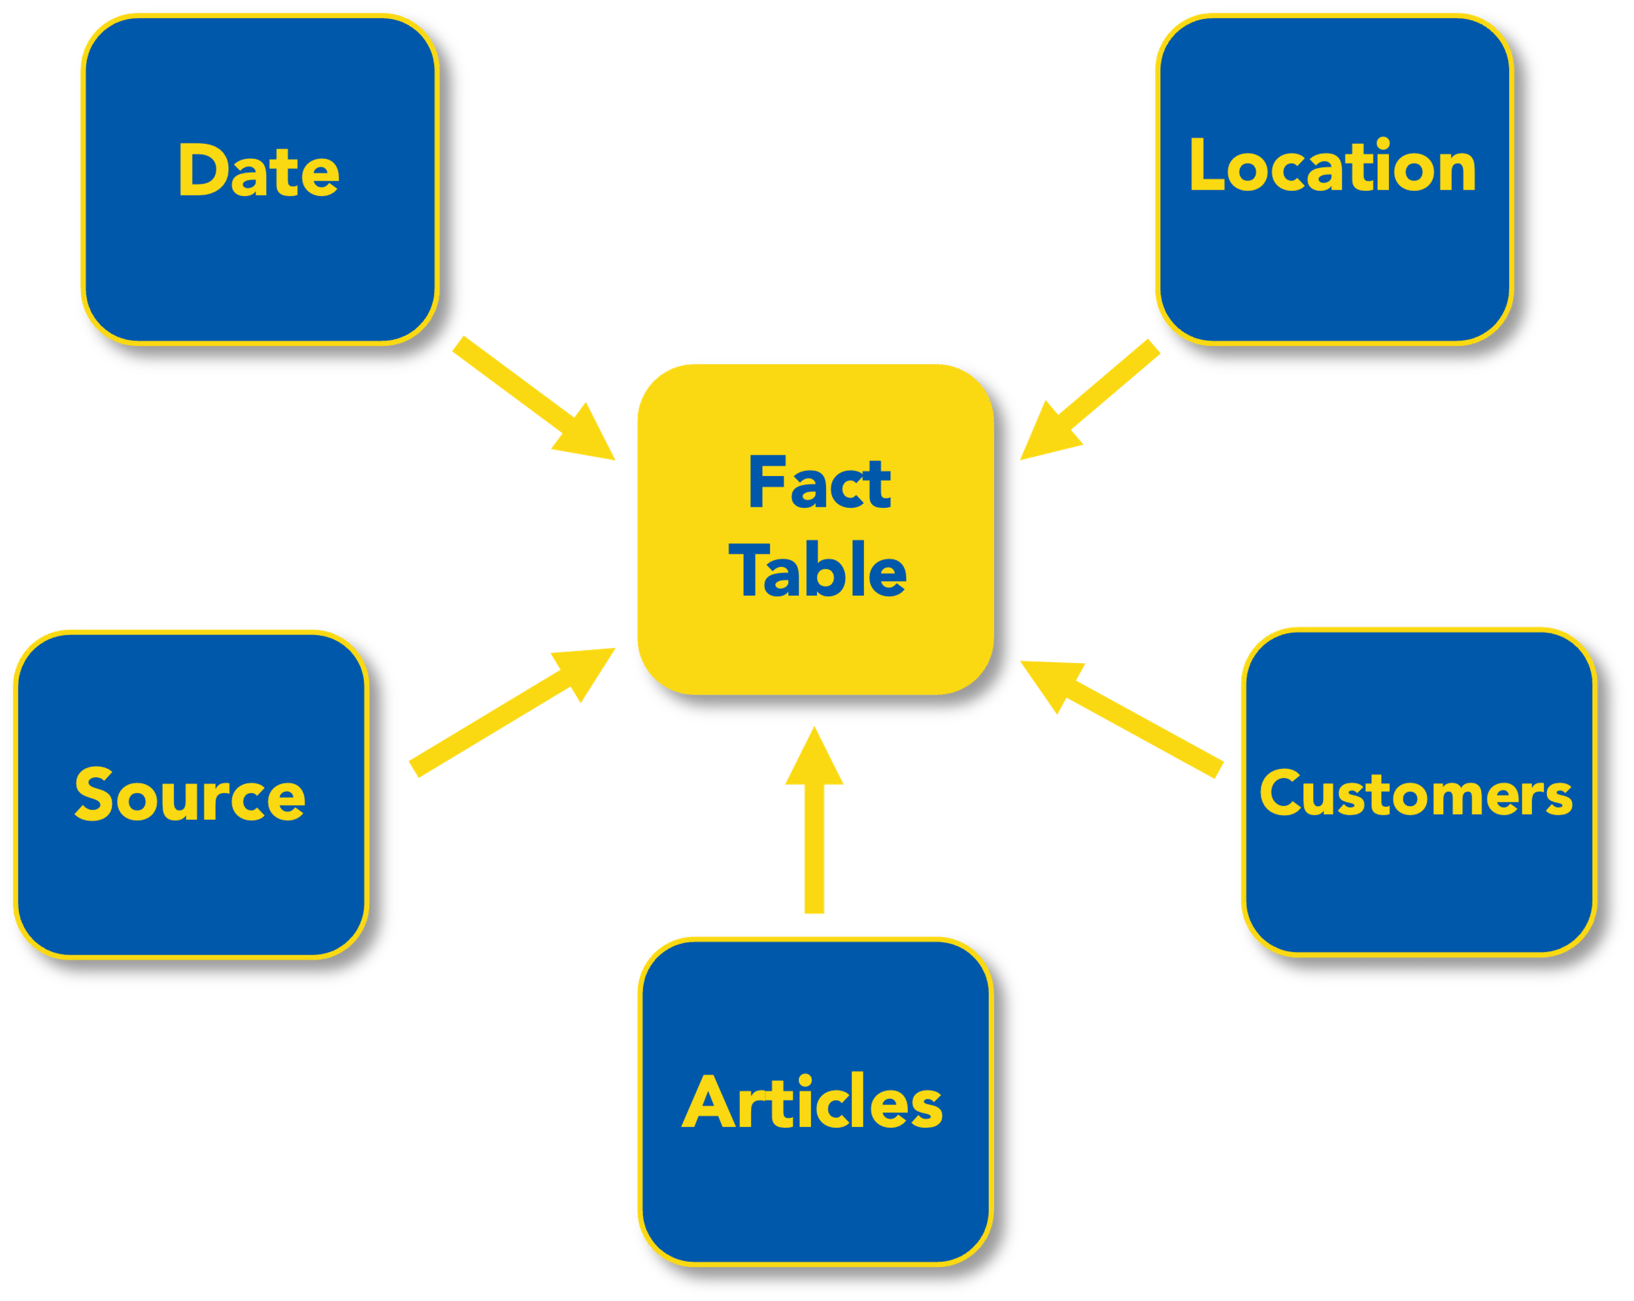
Network Insights
Living Room
Question:
How many distinct types of rooms
does each super room have?
Lvl 1:
Home Office
Room Headline | Distinct Count
Tables | 6
Shelving Units | 6
Cabinets | 5
Chairs | 5
Bedroom | 4
Beds | 4
Bedroom
Integral Part of Success
Why?
Beds
Cabinets
Lvl 2:
Tables
Shelves
Data Privacy Concerns
Value:
Increased visibility into the business
Add/remove rooms depending on demand
Beds: King & queen, twin, bunk
Decision-Making
Tables: Desks, nightstands, side tables
Lvl 3:
Attract untapped markets, evaluate ROI, channels success…
Less Data Expertise
Cabinets: Dressers, armoires, side boards
Many Possibilities
Shelves: Wall, display, bookcases
Problem Overview
Mission & Objectives
Room Network
Star Schema
Key Takeaways
Notes:
Jonathan

Slide 12
Star Schema – Marketing
IKEA S Model Focus: Marketing
Star
ROOM_HEADLINE | ROOM_COUNT
Tables | 6
Shelving Units | 6
Cabinets | 5
Chairs | 5
Bedroom | 4
Beds | 4
Why?
Integral Part of Success
Data Privacy Concerns
Decision-Making
Attract untapped markets, evaluate ROI, channels success…
Less Data Expertise
Many Possibilities
Problem Overview
Mission & Objectives
Room Network
Star Schema
Key Takeaways
What is the profit margin per product line for Western Canada (BC, AB, SASK, and MAN) business customers from the business-targeted social media campaigns in the past month (March 2023)?
When?
Where?
What?
How?
Who?
Order
Date
Customer Location
Product Lines
Order Source
Customer Type
Example Insight
Date
Location
Fact
Table
Source
Customers
Articles
Notes:
Extensive usage of Digital Marketing → settings are good for IKEA to have conversions
Reminder STAR: subset of data in data warehouses → simplicity and faster queries
IKEA STAR Model Focus → Marketing
Why?
Integral component of IKEA success (revenue & expense)
Many possibilities: How to attract untap market, see success of campaigns (ROI), channels success, etc.
Marketing campaigns requires quick decision-making to adjust to changing customer behaviors and market trends.
Less data expertise
Data privacy issues

Slide 13
Star Schema – Transactions
What is the profit margin per product line for Western Canada (BC, AB, SASK, and MAN) business customers from the business-targeted social media campaigns in the past month (March 2023)?
When?
Where?
What?
How?
Who?
Order
Date
Customer Location
Product Lines
Order Source
Customer Type
Example Insight
Transaction Database
Room Network
Marketing MDDB
Example Insight
What is the profit margin per product line for Western Canada (BC, AB, SASK, and MAN) business customers from the business-targeted social media campaigns in the past month (March 2023)?
When?
Where?
What?
How?
Who?
Order
Date
Customer Location
Product Lines
Order Source
Customer Type
Identifying high-performing categories and diagnose underperforming categories in different regions to inform key business decisions.
Problem Overview
Mission & Objectives
Room Network
Star Schema
Key Takeaways
Implementing databases will support IKEA’s digital growth via smooth operations and maintenance

Slide 14
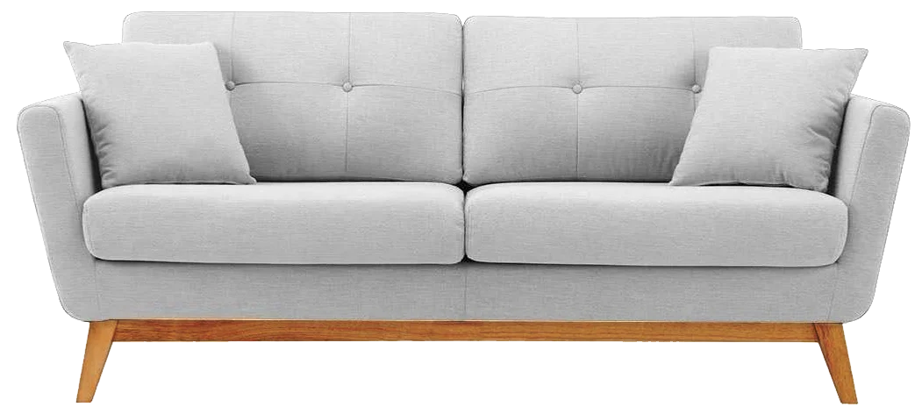
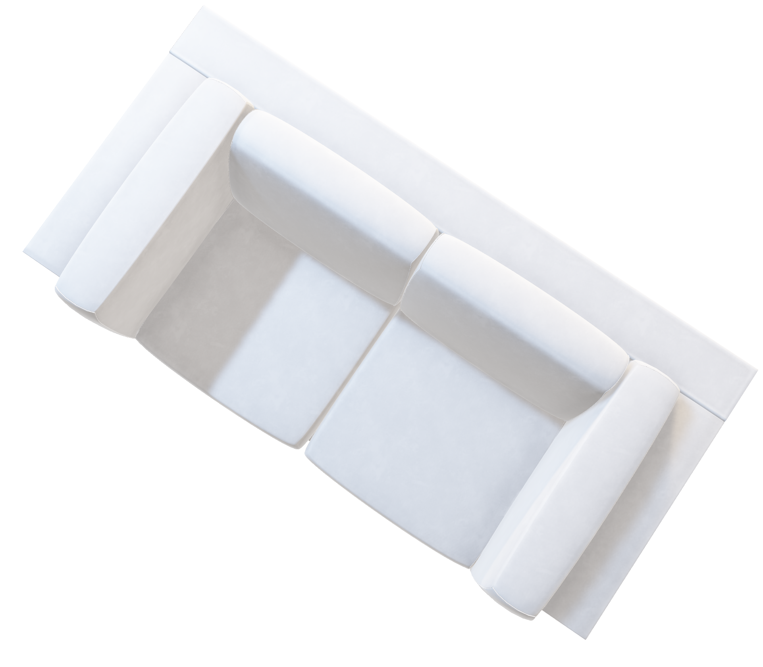
Key Takeaways
Transaction Database
Room Network
Marketing MDDB
Implementing databases will support IKEA’s digital growth via smooth operations and maintenance
Problem Overview
Mission & Objectives
Room Network
Star Schema
Key Takeaways
Notes:
Louis
To close this presentation:
What we are offering to your company
A model that able to support customer’s needs when interacting with the website as well as provide key information on strategic metrics
Done through a model that incorporates 3 things: Sales, view of data that focuses on room perspective, marketing department support
By implementing model to your operations, support your digital growth initiatives while smoothing operations and website maintenance

Slide 15


Thank You. Any Questions?
Problem Overview
Mission & Objectives
Room Network
Star Schema
Key Takeaways

Slide 16
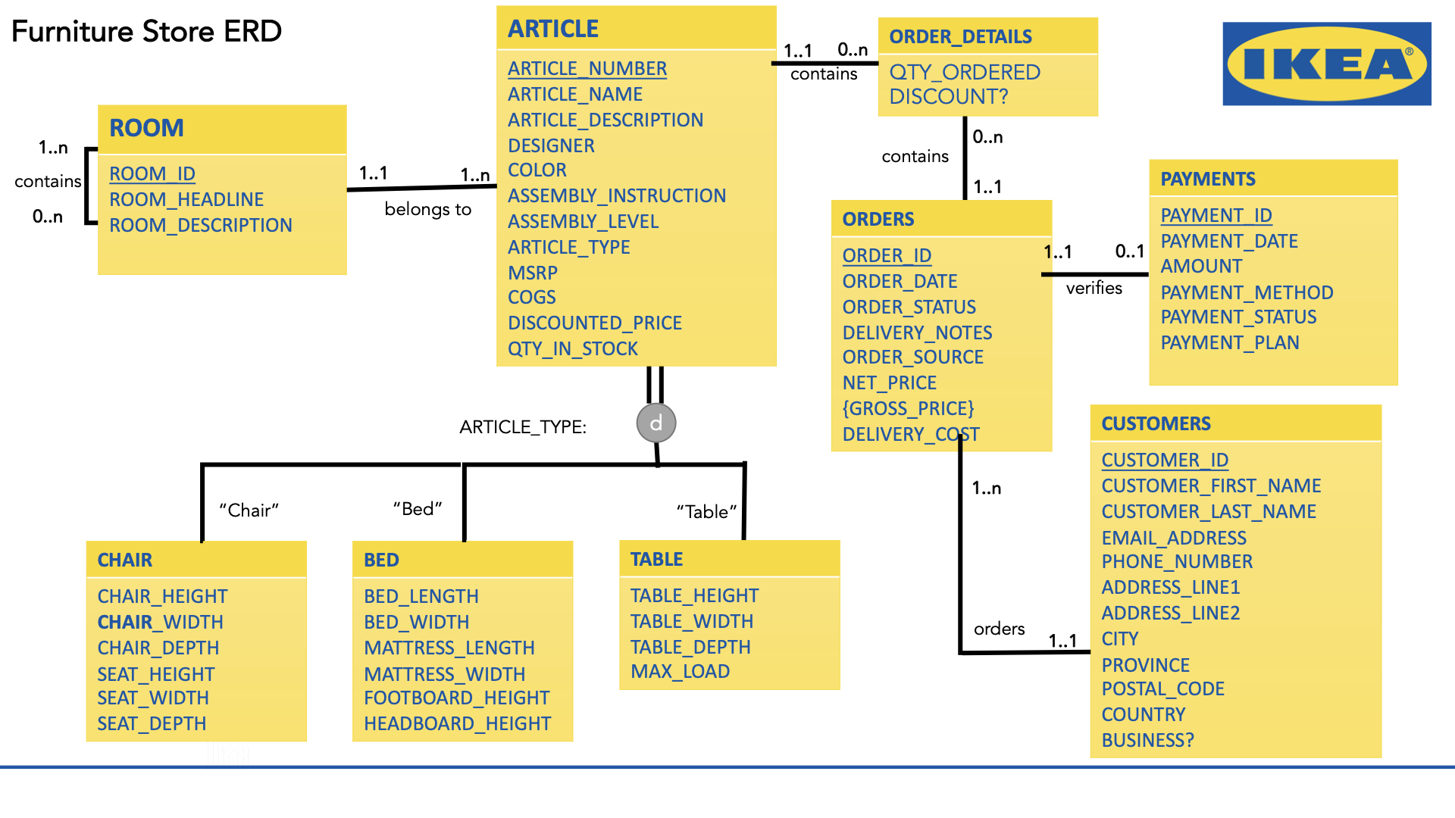
Appendix: Full EERD

Slide 17

Appendix: INVOICE
See Beyond Consulting Group

